Slide 1
Name:- Ankit Discipline:-Btech CSE[AIML] Semester:-1st Semester Subject-Web Development

Slide 2
INDEX
Introduction
Objective
Feasibility Study
Implementation Work
Application of software tools
Conclusion
Refrences

Slide 3
Introduction
I have made an online food delivery website using html and css by which users can select and order food from anywhere without going outside their home.
This website enables its customers to select and order the food items of their choice.

Slide 4
Objectives
My project aims to provide an idea of how a food delivery website looks like and how it can be designed beautifully to attract customers.
Through my project I want to achieve a clear understanding of
HTML (Hypertext markup language)and CSS (cascading style
Through my project I want to practically implement
the various tags of html and of CSS
that I have learnt during technical training.

Slide 5
Feasibility Study
The project involves Front End Development by using HTML and CSS keeping in mind the following points. :-
It includes different varieties of food by which customers find it easy to order food of their own choice.
The process of placing order is too simple.

Slide 6
Implementation work
Following are some major HTML tags used in my project:-
<Html>
<head>
<title>
<body>
<div>
<br>
<ul>, <li>
<a href=“ ”>
<table>,<tr>,<th>,<td>,etc.

Slide 7
Following are some major CSS tags used in my project:-
height: 100%;
width: 100%;
margin-top: 15px;
display: flex;
position: relative;
text-align: center;
background: white;
border-radius: 23px;
Color, padding,etc….

Slide 8
Application of Software tools
My project on “Food delivery services “ has been completed with the help of Sublime Text.
I loved the interface it has provided to its users that too for free and it runs really fast.

Slide 9
Conclusion
My project on “Food Delivery Services “ aims to provide an idea how a website providing such services can look like.
I have learnt how to use “VSCode” and “Sublime Text”.
I am able to practically implement all the html and css tags that I have learnt during technical training programme by “Shape my skills”.

Slide 10
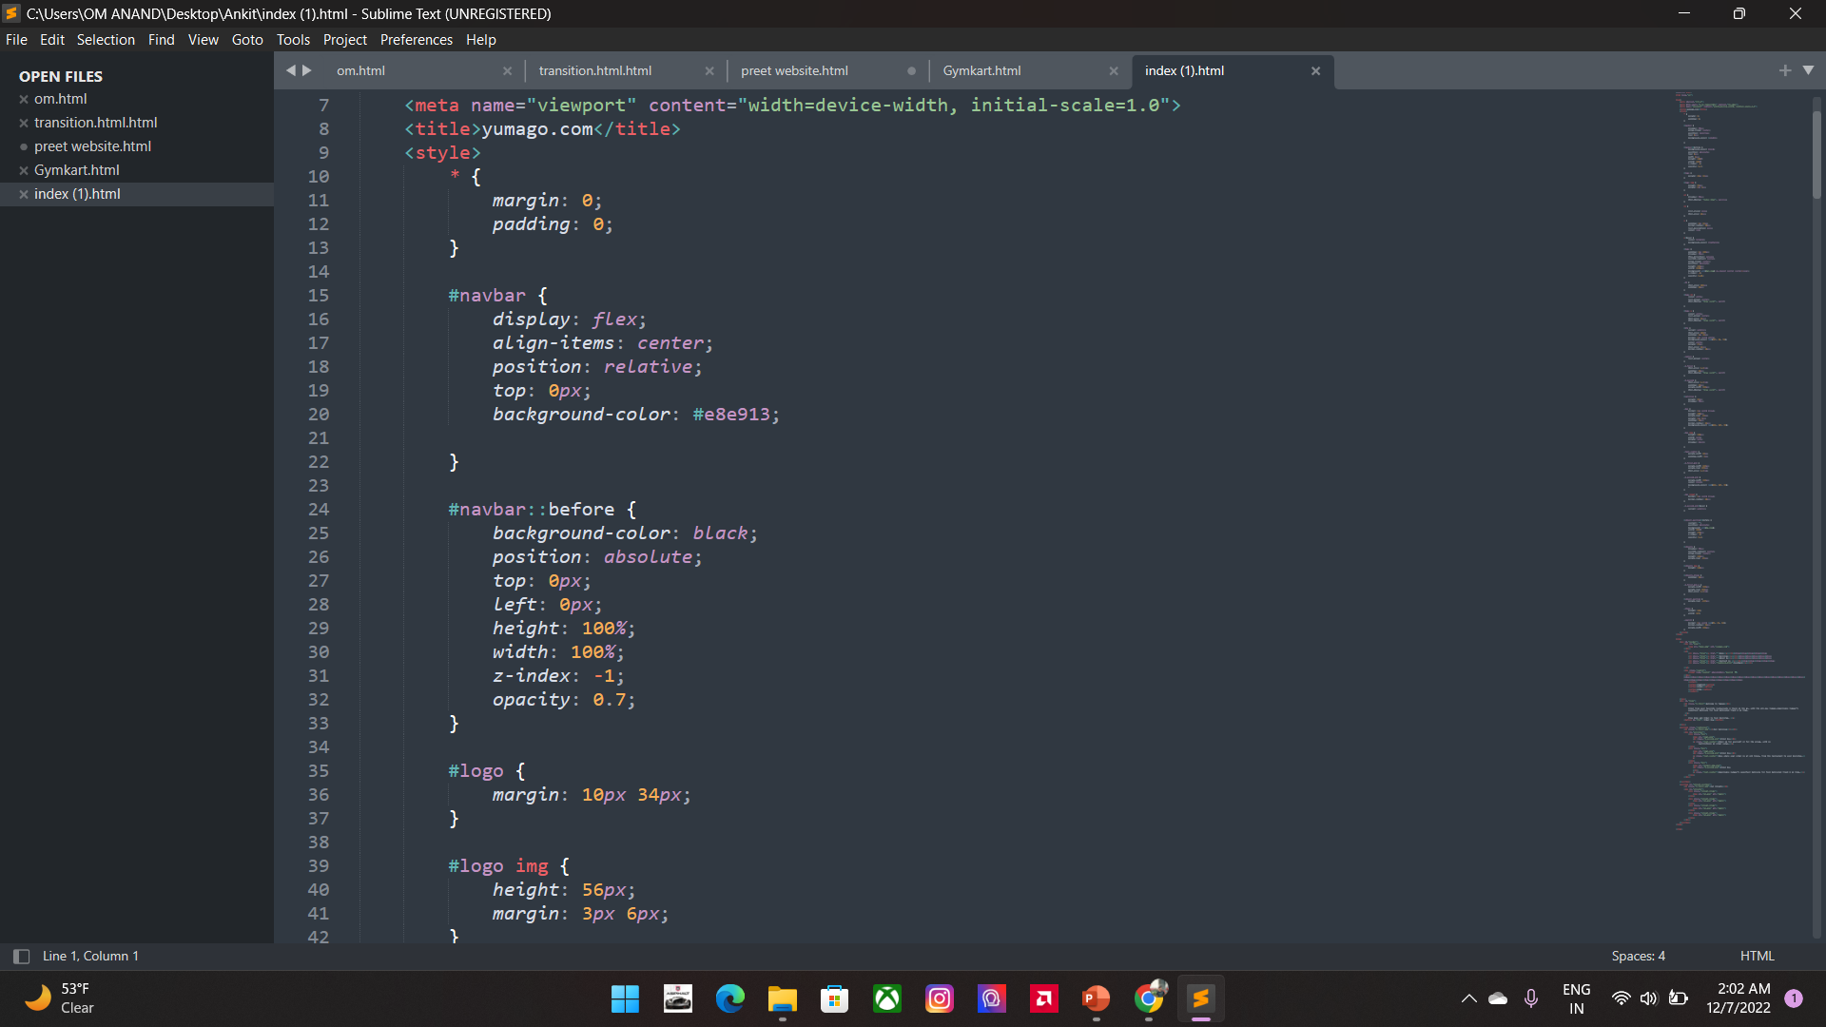
CSS

Slide 11
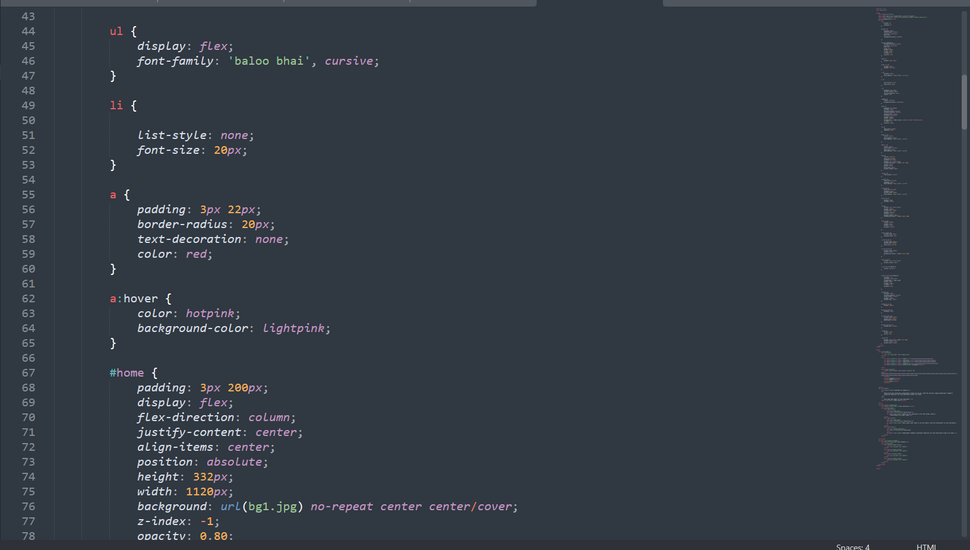

Slide 12
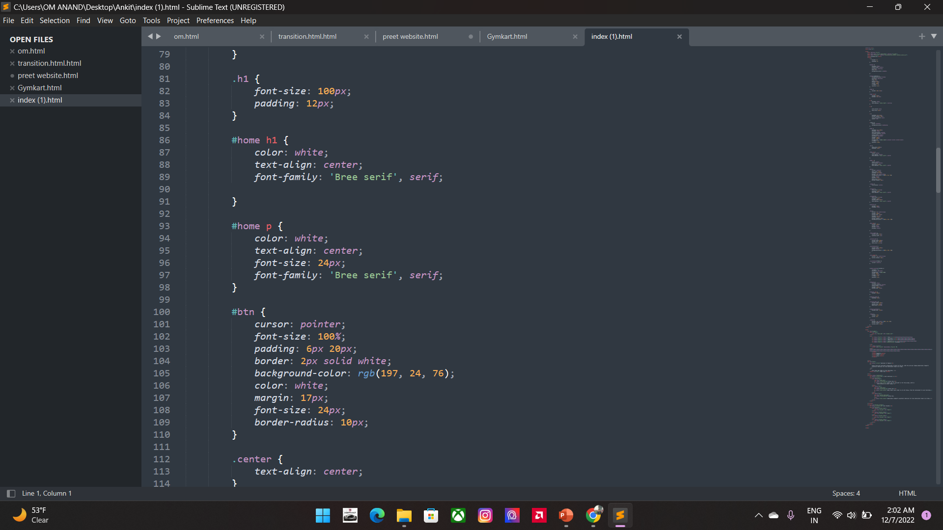
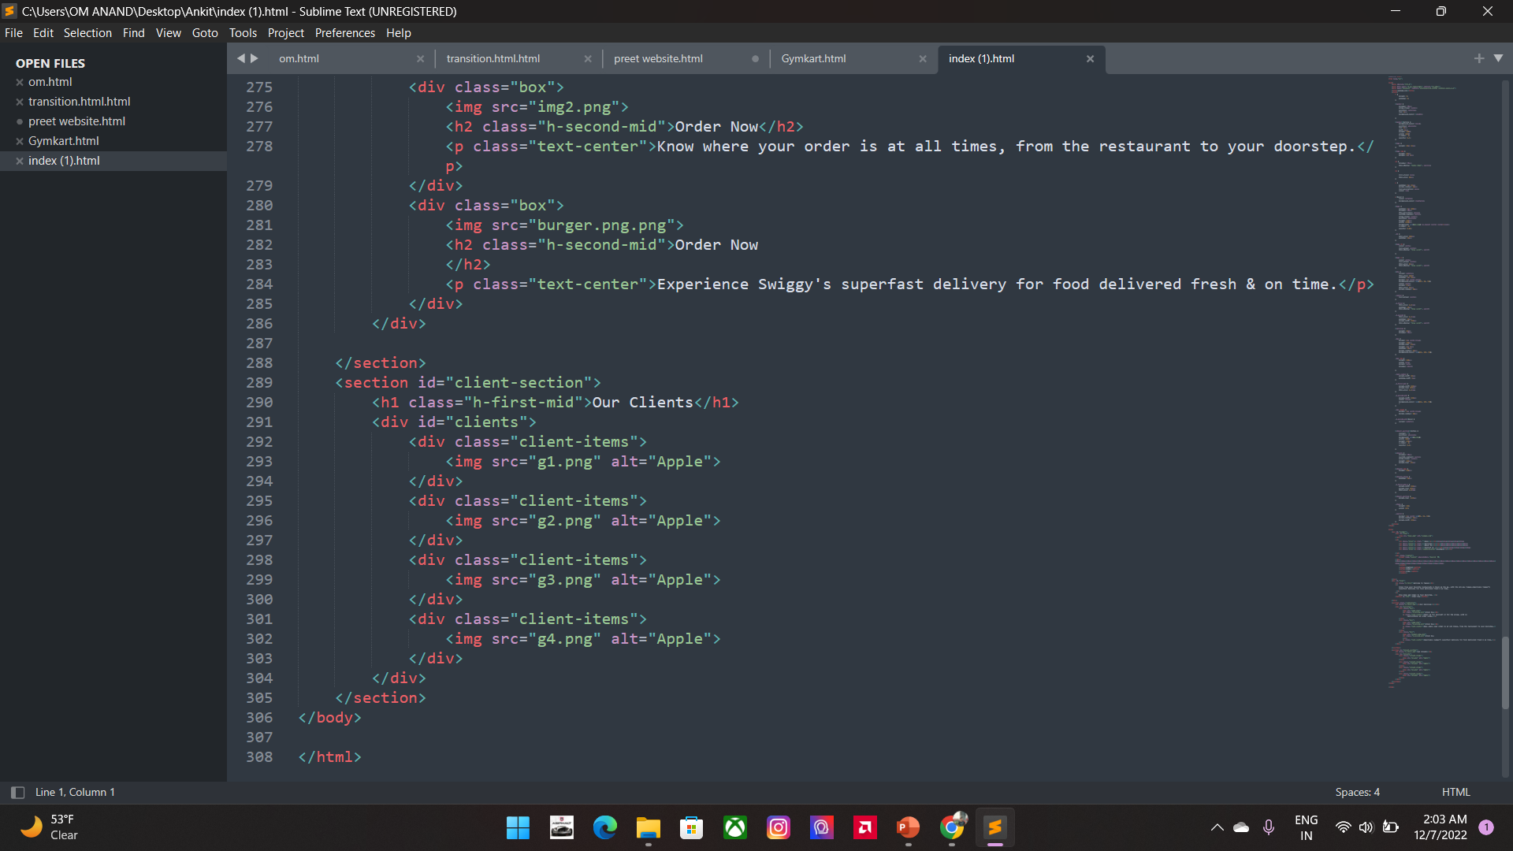

Slide 13
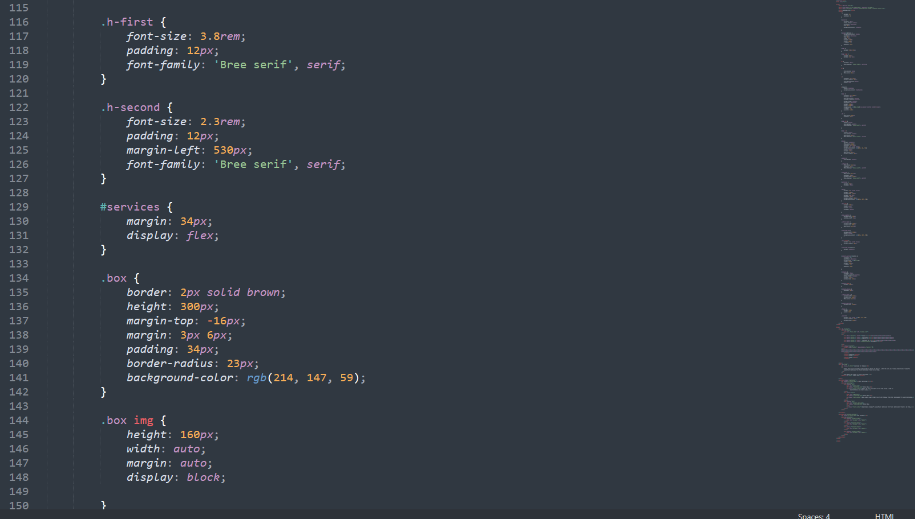

Slide 14
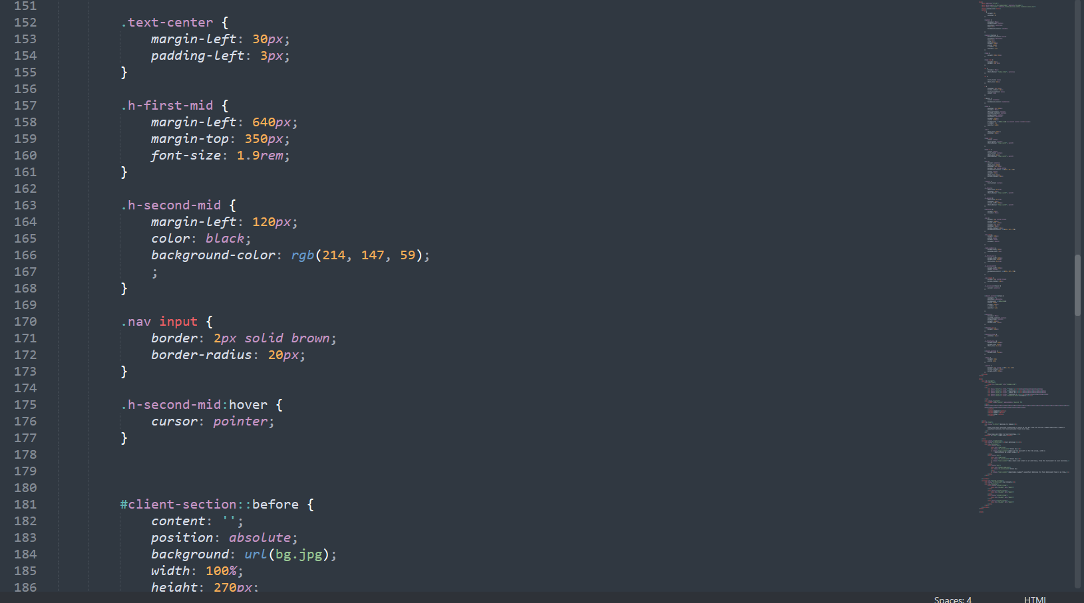

Slide 15
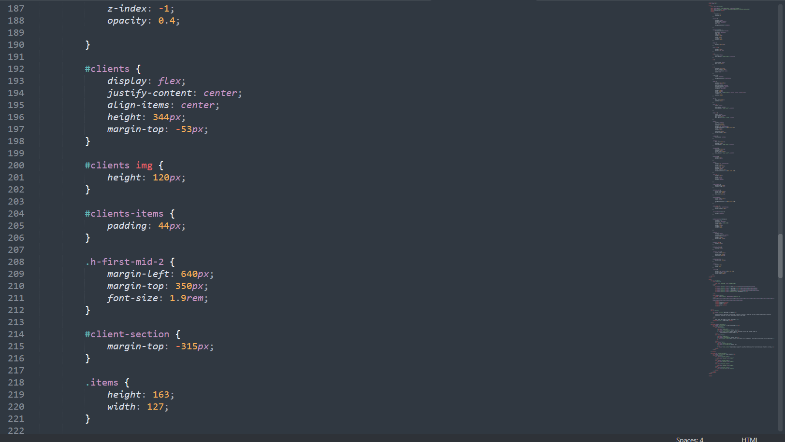

Slide 16
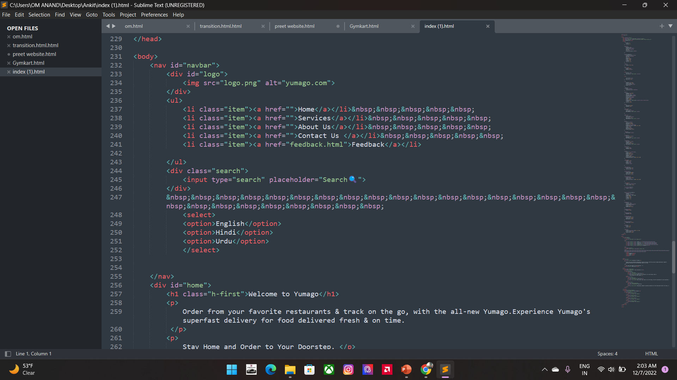
HTML

Slide 17
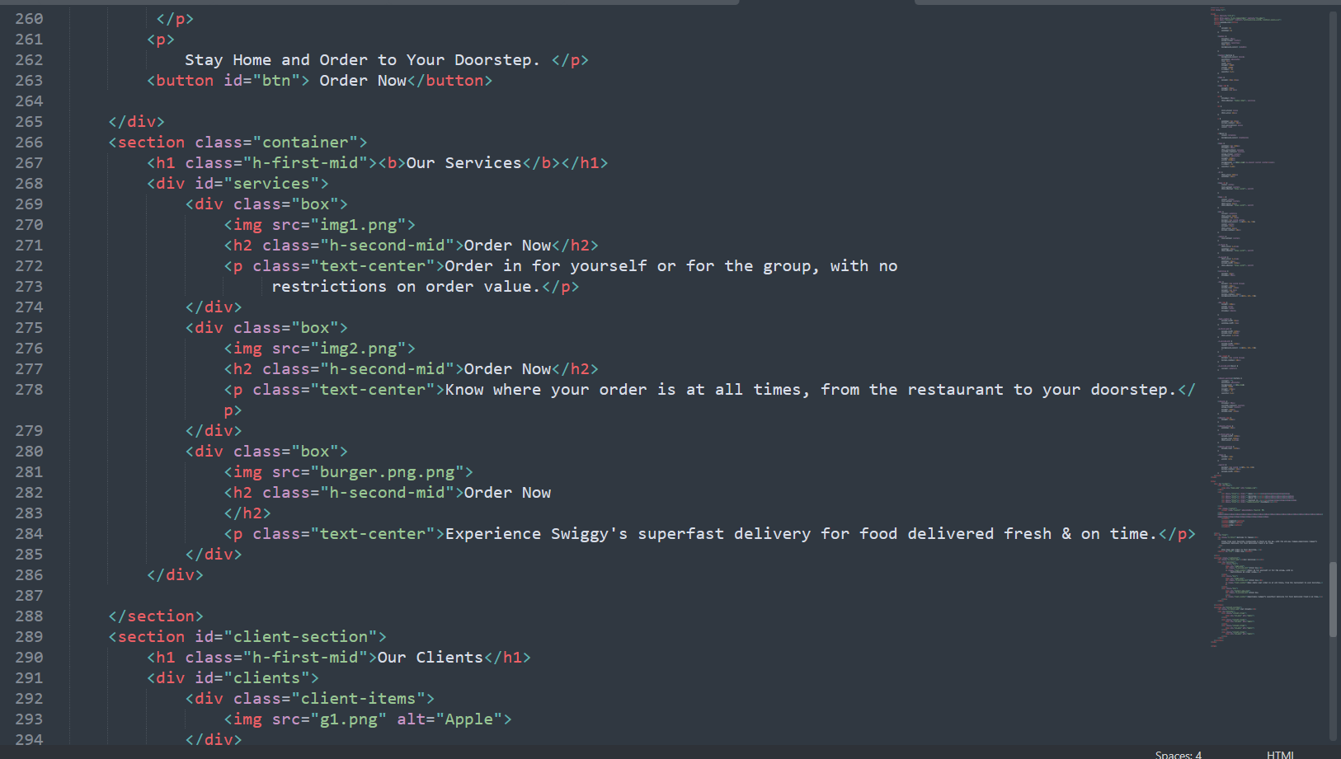

Slide 18


Slide 19
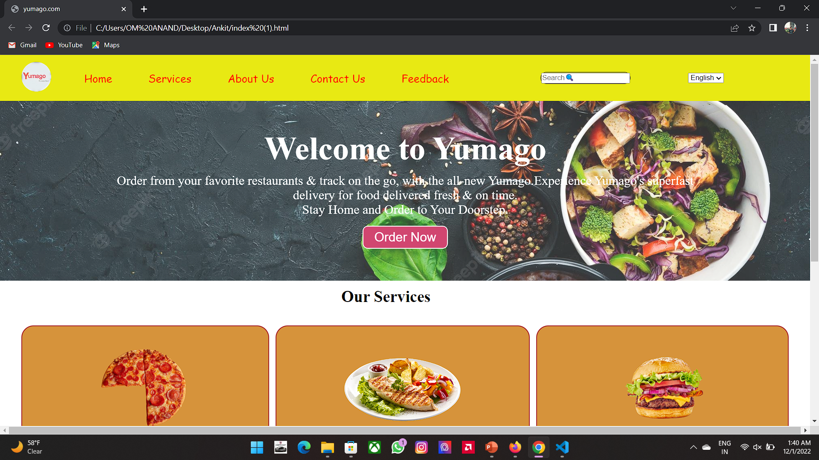
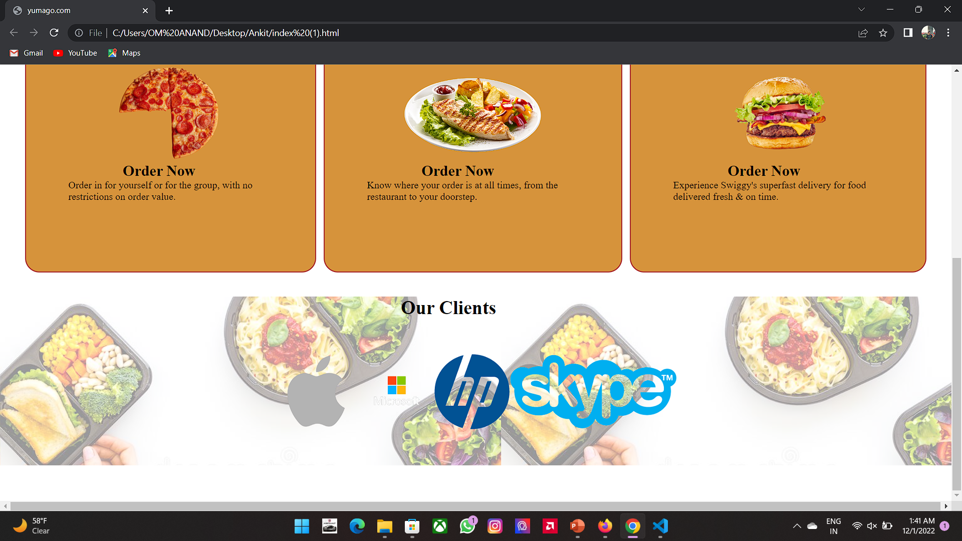

Slide 20
References
Google
VS Code
Sublime
Teacher

Slide 21

THANK YOU

